Slide 1
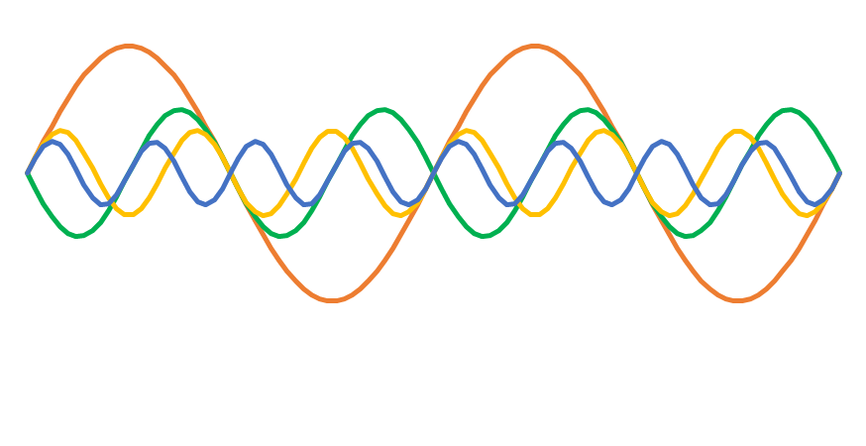
Oscillators and the Web Audio API
Josh Reiss
Professor of Audio Engineering
Queen Mary University of London
Blog: intelligentsoundengineering.wordpress.com/
Twitter: @IntelSoundEng
Youtube: www.youtube.com/user/IntelligentSoundEng
Publications: www.eecs.qmul.ac.uk/~josh/publications.htm

Slide 2
Oscillators
Any periodic signal is an oscillator
Additive synthesis - Any signal can be created by summing up lots of simple oscillators
Standard oscillators include
sine wave
triangle wave
square wave
sawtooth wave
Created with the Oscillator Node
Also allows you to create your own types of oscillators

Slide 3
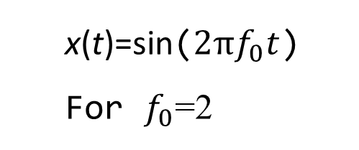
Sine wave
The basic building block of signals
x(t)=sin($2πf_{0}t$)
For $f_{0}$=2

Slide 4
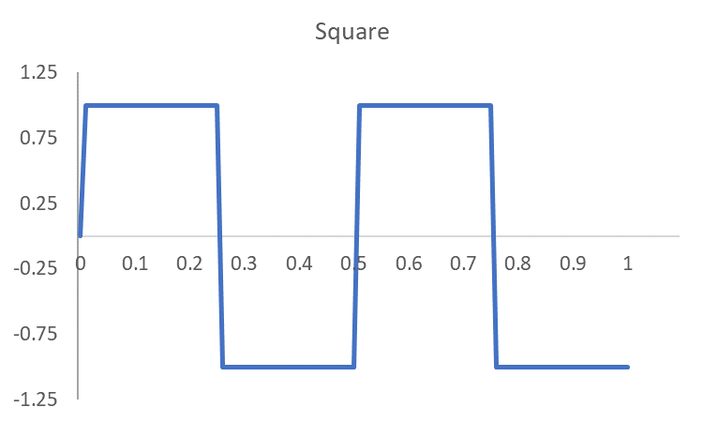

Square wave
The basic building block of signals
$$x\left(t\right)=sgn\left(sin\left(2πf_{0}t\right)\right)$$

Slide 5
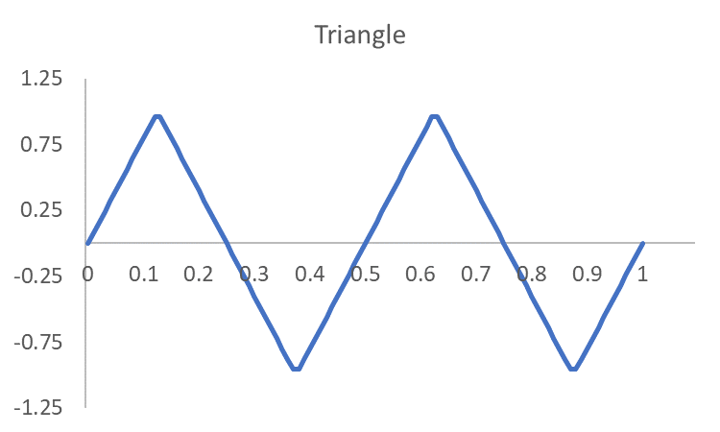

Triangle wave
The basic building block of signals
$$x\left(t\right)=4\left|f_{0}t−\left\lfloor f_{0}t+1/2\right\rfloor \right|−1$$

Slide 6
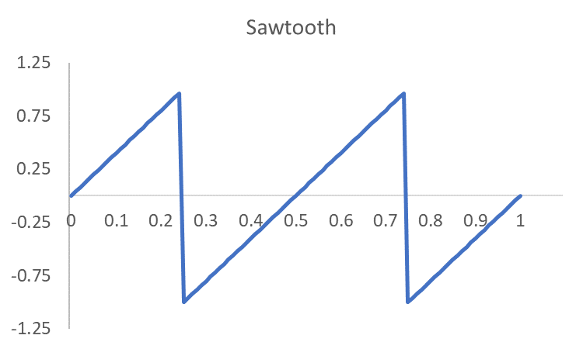

Sawtooth wave
The basic building block of signals
$$x\left(t\right)=2\left(f_{0}t−\left\lfloor f_{0}t+1/2\right\rfloor \right)$$

Slide 7
The Oscillator Node
Usage
or
Parameters
type: Waveform shape; "sine" (default), "square", "sawtooth", "triangle“ or "custom"
frequency: Frequency (in Hertz) of the periodic waveform. Default value is 440
Detune: Offset the frequency by an amount (in cents) . Default is 0. So frequency becomes;
computedOscFrequency = frequency⋅2^{detune / 1200}
var Tone = new OscillatorNode(context,{type:'sine',frequency:'440'})
Tone.start()
var Tone = context.createOscillator()
Tone.type = 'sine'
Tone.frequency.value = 440
Tone.start()

Slide 8
How do you create your own custom oscillator type?

Slide 9
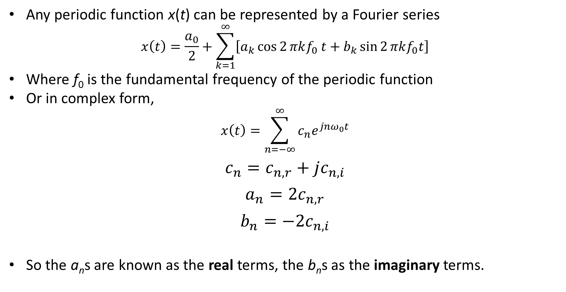
Fourier series
Any periodic function x(t) can be represented by a Fourier series
$$x\left(t\right)=\frac{a_{0}}{2}+\sum_{k=1}^{∞}{\left[a_{k}\cos{2}πkf_{0} t+b_{k}\sin{2}πkf_{0}t\right]}$$
Where f₀ is the fundamental frequency of the periodic function
Or in complex form,
$$x\left(t\right)=\sum_{n=−∞}^{∞}{c_{n}e^{jnω_{0}t}}$$
$$c_{n}=c_{n,r}+jc_{n,i}$$
$$a_{n}=2c_{n,r}$$
$$b_{n}=−2c_{n,i}$$
So the a_{n}s are known as the real terms, the b_{n}s as the imaginary terms.

Slide 10
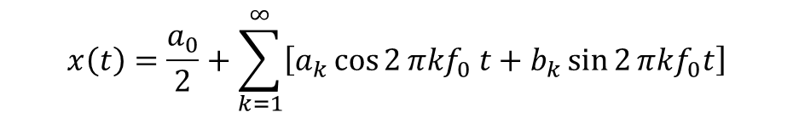
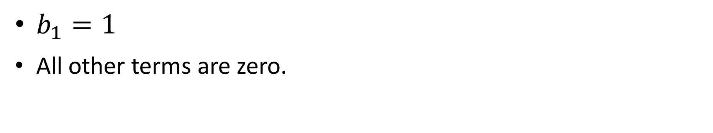
Example: Sine wave
$$x\left(t\right)=\frac{a_{0}}{2}+\sum_{k=1}^{∞}{\left[a_{k}\cos{2}πkf_{0} t+b_{k}\sin{2}πkf_{0}t\right]}$$
x(t)=sin($2πf_{0}t$)
For $f_{0}$=2
$b_{1}=1$
All other terms are zero.

Slide 11
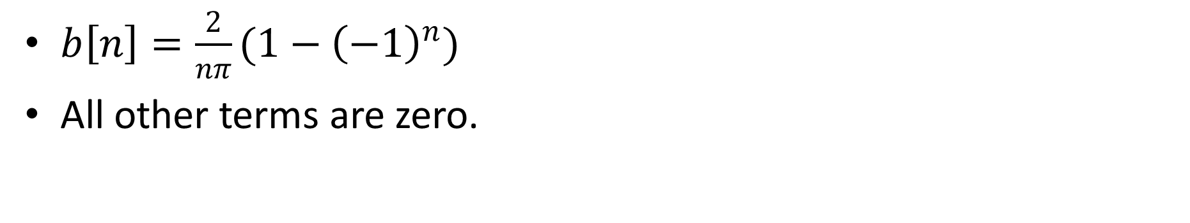
Example: Square wave
$$x\left(t\right)=\frac{a_{0}}{2}+\sum_{k=1}^{∞}{\left[a_{k}\cos{2}πkf_{0} t+b_{k}\sin{2}πkf_{0}t\right]}$$
First 3 terms.
$b\left[n\right]=\frac{2}{nπ}{(1−\left(−1\right)}^{n})$
All other terms are zero.

Slide 12
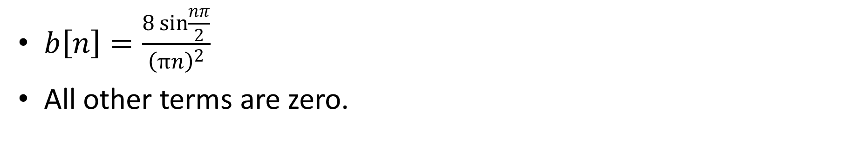
Example: Triangle wave
$$x\left(t\right)=\frac{a_{0}}{2}+\sum_{k=1}^{∞}{\left[a_{k}\cos{2}πkf_{0} t+b_{k}\sin{2}πkf_{0}t\right]}$$
First 3 terms.
$b\left[n\right]=\frac{8\sin{\frac{nπ}{2}}}{{\left(πn\right)}^{2}}$
All other terms are zero.

Slide 13
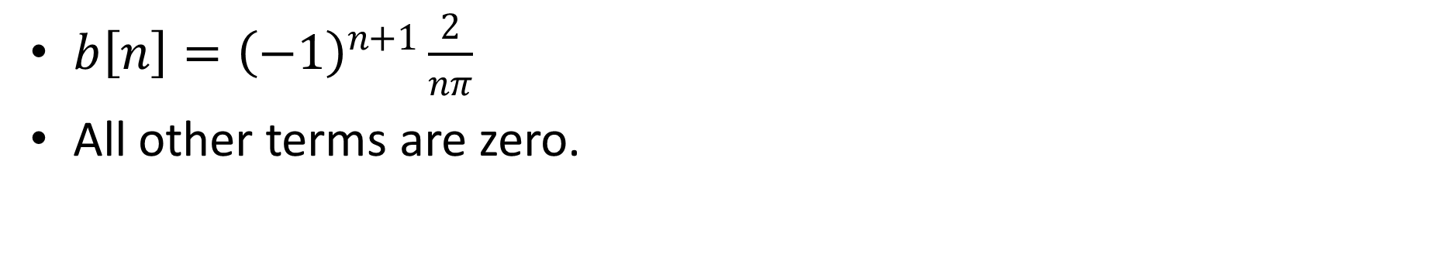
Example: Sawtooth wave
$$x\left(t\right)=\frac{a_{0}}{2}+\sum_{k=1}^{∞}{\left[a_{k}\cos{2}πkf_{0} t+b_{k}\sin{2}πkf_{0}t\right]}$$
First 3 terms.
$b\left[n\right]={\left(−1\right)}^{n+1}\frac{2}{nπ}$
All other terms are zero.

Slide 14
How many terms do you need in the Fourier Series?

Slide 15
Aliasing
Aliasing
When signals become indistinguishable due to sampling
Shannon-Nyquist sampling theorem
You need to sample at least twice every period
in other words
Sampling frequency should be at least twice the highest frequency in the signal
Highest frequency in the signal should be less than half the sampling frequency
Nyquist frequency= f_{s}/2
Two sinusoids, with frequency 3 Hz and 7 Hz
They appear identical when sampled at a frequency 10 Hz

Slide 16
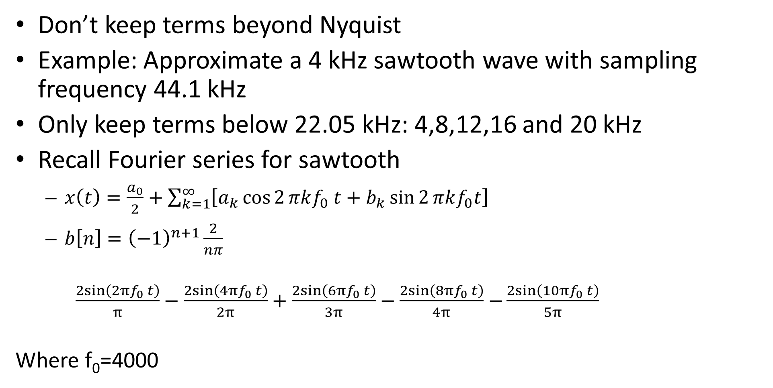
How many terms do you need in the Fourier Series?
Don’t keep terms beyond Nyquist
Example: Approximate a 4 kHz sawtooth wave with sampling frequency 44.1 kHz
Only keep terms below 22.05 kHz: 4,8,12,16 and 20 kHz
Recall Fourier series for sawtooth
$x\left(t\right)=\frac{a_{0}}{2}+\sum_{k=1}^{∞}{\left[a_{k}\cos{2}πkf_{0} t+b_{k}\sin{2}πkf_{0}t\right]}$
$b\left[n\right]={\left(−1\right)}^{n+1}\frac{2}{nπ}$
$\frac{2sin\left(2πf_{0} t\right)}{π}−\frac{2sin\left(4πf_{0} t\right)}{2π}+\frac{2sin\left(6πf_{0} t\right)}{3π}−\frac{2sin\left(8πf_{0} t\right)}{4π}$ $−\frac{2sin\left(10πf_{0} t\right)}{5π}$
Where f₀=4000

Slide 17
PeriodicWave
The Web Audio API allows you to create your own oscillator type with createPeriodicWave() and setPeriodicWave()
Create arrays of a values and b values for Fourier Series
Create the periodic wave by calling the audio context’s createPeriodicWave with a[] and b[]
Call the oscillator node’s setPeriodicWave with the periodic wave you just created
let source= context.createOscillator();
let a = new Float32Array(2);
let b = new Float32Array(2);
b[1]=1;
let myWave = context.createPeriodicWave(a,b);
source.setPeriodicWave(myWave);

Slide 18
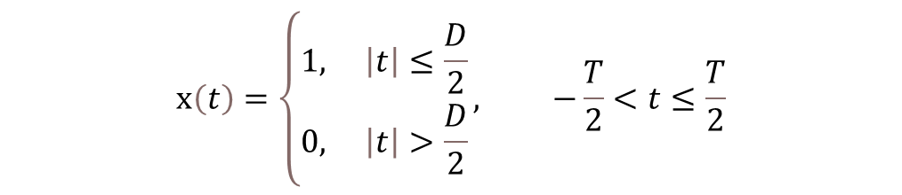
Pulse wave example
Square wave is a special case of a pulse wave
Pulse wave has an additional parameter,
duty cycle = percentage of its period spent at its maximum value
Square wave has duty cycle of 50%.
Consider pulse wave with a few more differences from the square wave
Flips back and forth between 1 and 0, not +1 and -1
Period T, duty cycle D/T
At its maximum from time -D/2 to +D/2.
We can write one period as;
Pulse wave, 75% duty cycle, 2 Hz frequency
$$x\left(t\right)=\left\{\begin{aligned}&1, \left|t\right|≤\frac{D}{2} \\ &0, \left|t\right|>\frac{D}{2}\end{aligned}\right., −\frac{T}{2}<t≤\frac{T}{2}$$

Slide 19

Pulse wave example
<button onclick="context.resume()">Start</button>
<p>Frequency</p>
<input type="range" min=1 max=1000 value=10 id="Frequency">
<p>Duty Cycle</p>
<input type="range" max=1 step='any' value=0.5 id="DutyCycle">
<script>
let context= new AudioContext();
let source= new OscillatorNode(context,{frequency:10});
var maxCoef= context.sampleRate/(2*source.frequency.value);
var a = new Float32Array(context.sampleRate/2);
var b = new Float32Array(context.sampleRate/2);
real[0]=0,imag[0]=0;
for (i=1;i<maxCoef;i++) a[i]= 2*Math.sin(i*Math.PI*DutyCycle.value)/(i*Math.PI);
source.setPeriodicWave(context.createPeriodicWave(a,b));
source.connect(context.destination);
source.start();
Frequency.oninput = function() { source.frequency.value = this.value }
DutyCycle.oninput = function() {
maxCoef= context.sampleRate/(2*source.frequency.value);
for (i=1;i<maxCoef;i++) real[i]= 2*Math.sin(i*Math.PI*DutyCycle.value)/(i*Math.PI);
source.setPeriodicWave(context.createPeriodicWave(real,imag));
}
</script>
Coefficients are known to be
Only keep terms in Fourier series below Nyquist
Set the coefficients of the Fourier series
$$a_{0}=2\text{D}\text{/}\text{T},a_{n}=\frac{\left.2sin(nπD/T\right)}{nπ}$$
Create and set the periodic wave on one line
Recalculate the coefficients, up to Nyquist, for this new Duty Cycle
Why is there an offset?

